Slide 1
Final report
Author: Huynh thi cam thu

Slide 2
contents
Requirement
Technical skills
Demo app

Slide 3
I. Requirement
Name | Descriptions | Start date | End date | Progress
Task | Build a mockup UI for the car parking app: Sign in, Sign Up, Car Parking, Receipt The interface select & confirm to pay for the parking spot The interface to make choice to extend the time or not | March 28, 2016 | April 7, 2016 | Finished

Slide 4
II. Technical
HTML5, CSS3 to design app
AngularJS show mockup data and event handing
Angular Material create UI components based on Material Design.
Cordova framework to build app run on Android platform

Slide 5
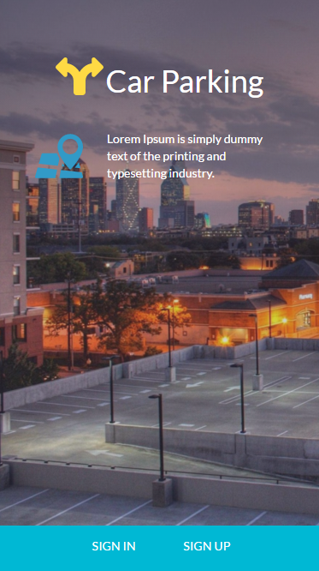
1. Homepage

Slide 6
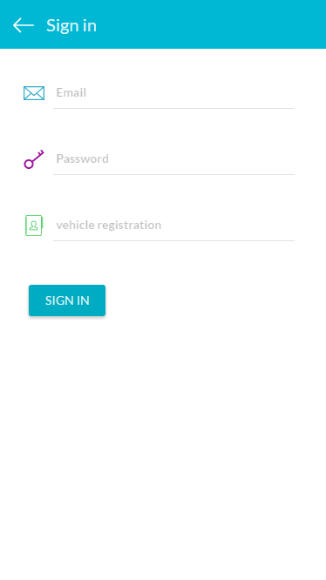
2. Sign In

Slide 7
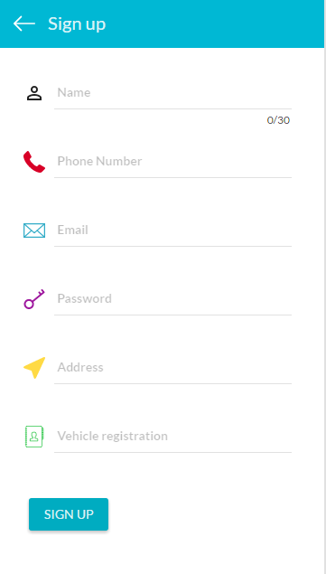
3. Sign Up

Slide 8
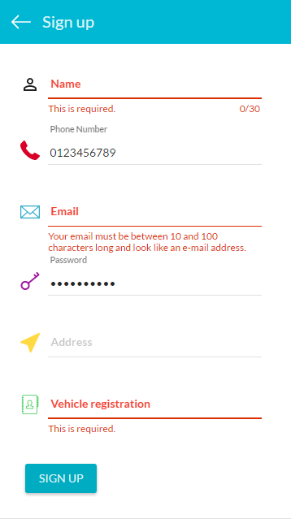
4. Sign Up Validate

Slide 9
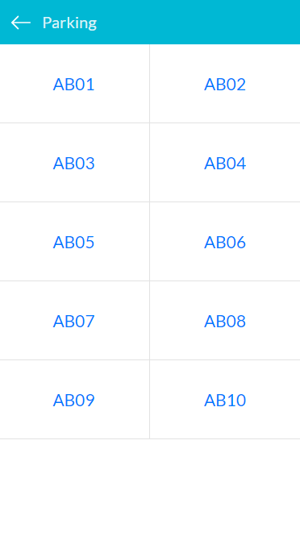
5. Parking Slot

Slide 10
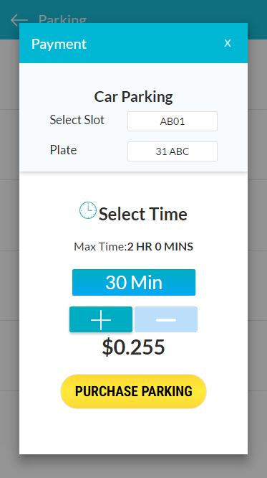
6. Popup Payment

Slide 11
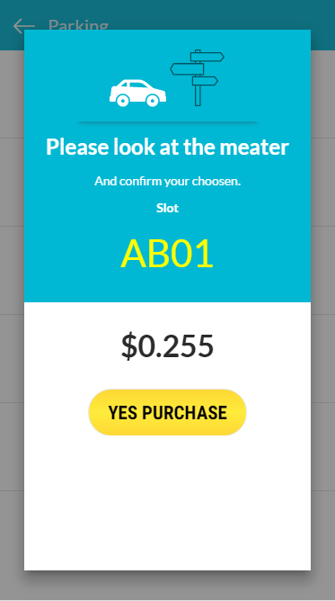
7. Confirm Purchase

Slide 12
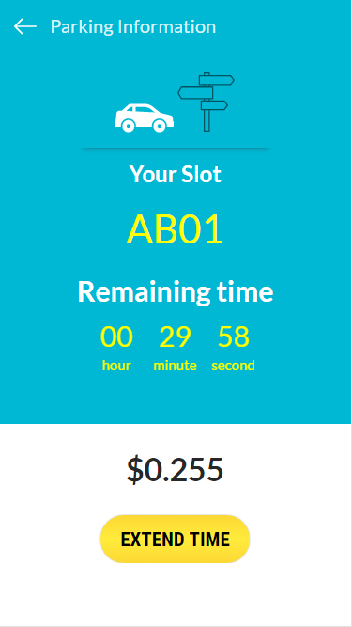
8. Receipt

Slide 13
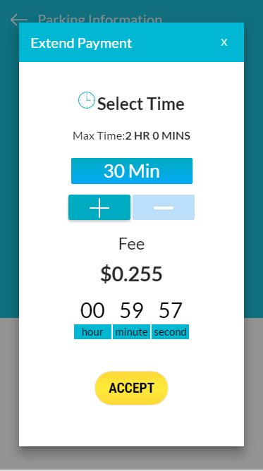
9. Popup Extend

Slide 14
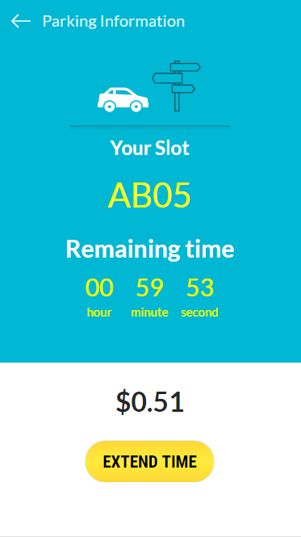
10. Receipt

Slide 15
Thanks for following!

